Slide 1
DEPAUL SLACKERS
TEAM: ARTURO ALVAREZ, SUNNY SYED, TABISH ANSARI, MICHAEL WEIRS, YONGSHAN TAN, AUSTIN CARTER.

Slide 2
PROBLEM
Graduate CS and IS students do not have a place where can quickly see what courses they need to take and the fastest set of classes they can take to graduate.

Slide 3
SOLUTION
Create a website called When If where Graduate CS and IS students and easily quickly see what courses they need to take and the fastest set of classes they can take to graduate.

Slide 4
REQUIREMENTS
Purpose: Build BUSINESS solutions NOT technical solutions.
Focus: Customer (ex. Student & Faculty) NEEDS and WANTS
REQUIREMENTS:
Up to date Website (NEED)
List of classes (NEED)
List of scheduled timings for classes (quarters offered, duration, dates)
Login/Password (NEED)
Fastest route to graduate (NEED & WANT) (includes:
Introductory Courses
Foundation Courses
Major Elective Courses
Advancement Courses
6)”Search” Directory (NEED)
7) Student Directory (for Faculty use → during Advising) (NEED)
1) Student Applies
2) Admin responds to application
3) Student able to login
4) Browse Courses
5) Course Degree Requirement
6) Browse Search History
7) Run New Search
8) Results Screen
9) Displays 5 shortest paths to graduation

Slide 5
HARDWARE
Ubuntu Server hosted on Amazon Web Services (AWS)
RDS MySQL Server setup and running on AWS

Slide 6
SOFTWARE
Nginx
Web2py
MySQL
HTML, CSS, JavaScript and Bootstrap
BeautifulSoup (Python Web Scraping Library)

Slide 7
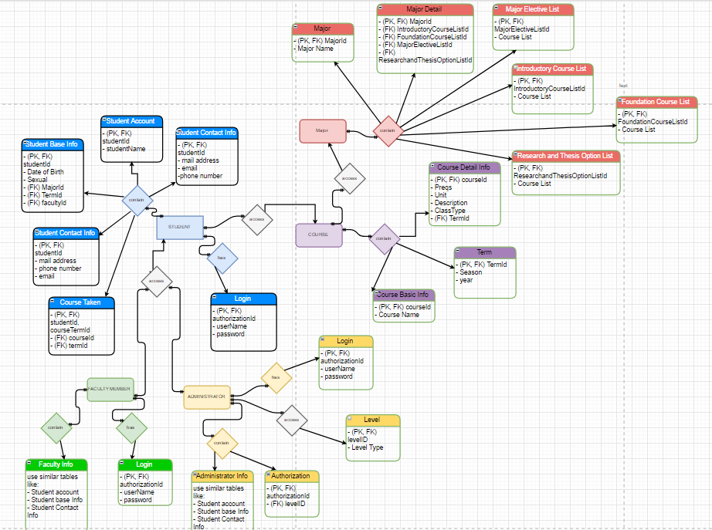
DATABASE

Slide 8
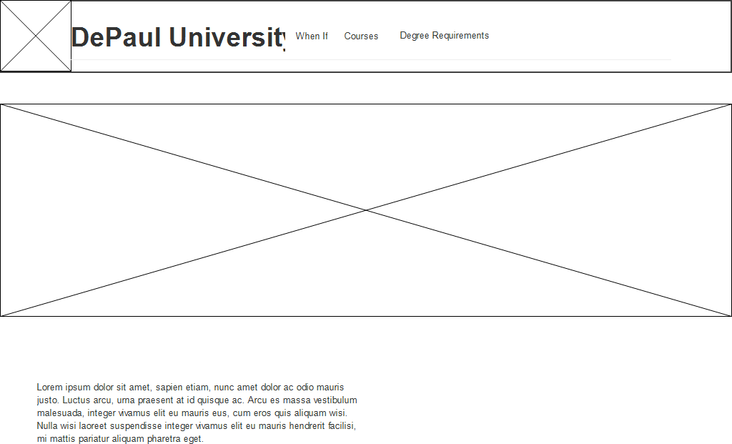
DESIGN

Slide 9
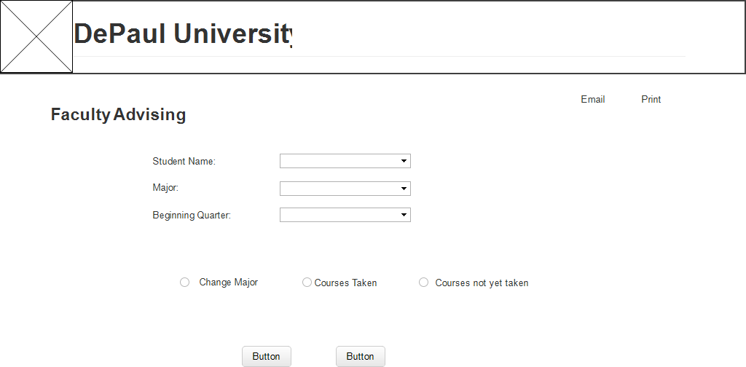
CONTINUED

Slide 10
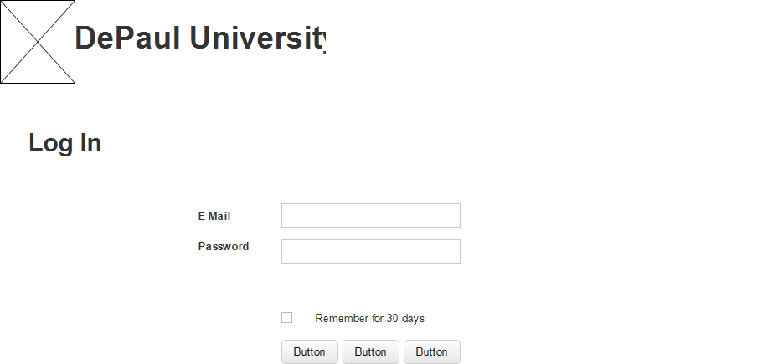
CONTINUED

Slide 11
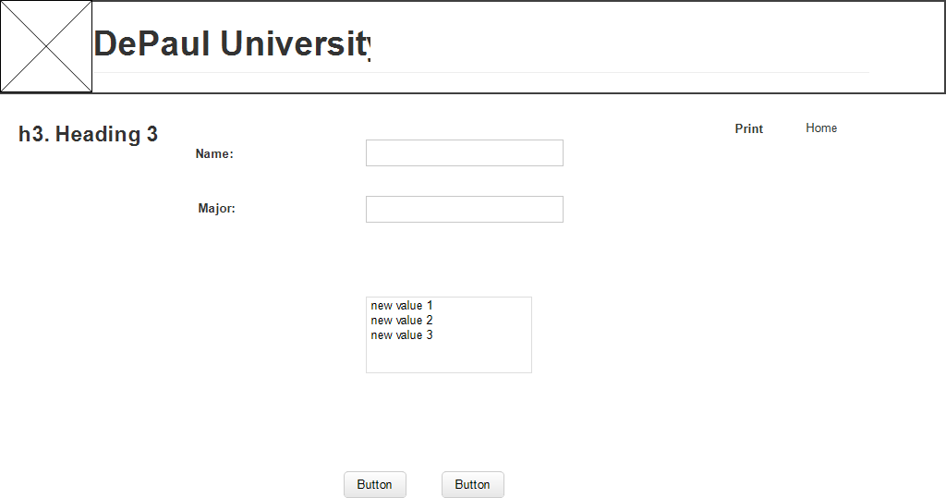
CONTINUED

